Slide 1
The Medium Access Control Sublayer
Chapter 4

Slide 2

The Channel Allocation Problem
The MAC (Medium Access Control) sublayer is between the physical layer and the data link layer.
The MAC sublayer is especially important in LANs, nearly all of which use a multi-access (or broadcast) channel as the basis of their networks.
This chapter mainly deals with LANs, other broadcast networks and their protocols. The key issue: how to determine who gets to use the channel when there is competition for it ?

Slide 3

Pure ALOHA
The ALOHA system was used for ground-based radio broadcasting, but the basic idea is applicable to any system in which uncoordinated users are competing for the use of a single shared channel.
Basic idea:
  Let users transmit whenever they have data to be sent.
  A sender can always find out whether or not its frame was destroyed by listening to the channel output (due to the feedback property of broadcasting).
  If the frame was destroyed, the sender just waits a random amount of time and sends it again.
Systems in which multiple users share a common channel in a way that can lead to conflicts are known as contention systems.

Slide 4
Pure ALOHA cont.
In pure ALOHA, frames are transmitted at completely arbitrary times.
User
A
B
C
D
E
Time

Slide 5
Slotted ALOHA
Slotted ALOHA system:
  Time is divided up into discrete intervals, each interval corresponding to one frame.
  A terminal is not permitted to send until the beginning of the next slot.
User
A
B
C
D
E
Time

Slide 6
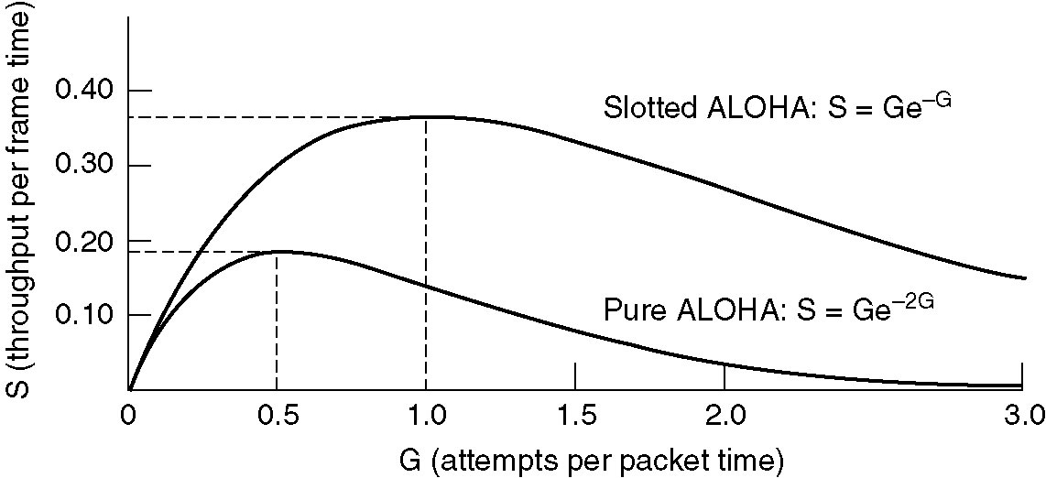

Slotted ALOHA cont.
Slotted ALOHA peaks at G = 1, with S = 1/e ≈ 0.368, twice that of pure ALOHA. The main reason for poor channel utilization of ALOHA (pure or slotted) is that all stations can transmit at will, without paying attention to what the other stations are doing.

Slide 7
CSMA (Carrier Sense Multiple Access) Protocols
Protocols in which stations listen for a carrier (i.e., a transmission) and act accordingly are called carrier sense protocols.
1-persistent CSMA:
  To send data, a station first listens to the channel to see if anyone else is transmitting.
  If so, the station waits (keeps sensing it) until the channel becomes idle. Otherwise, it transmits a frame.
It is called 1-persistent because the station transmits with a probability of 1 whenever it starts sensing the channel and finds the channel idle.

Slide 8

Collisions in CSMA
How could collisions happen in CSMA ?
  Whenever more than one station detect an idle channel and their transmission times overlap.
Discussions
  What's the effect of signal propagation delay ?
    The longer the delay, the more the collisions, and the worse the performance of the protocol.
  How about zero propagation delay ?
    There still exist chances of collisions.
  Is this protocol any better than ALOHA (both pure and slotted) ?
    Yes, because both stations have the decency to desist from interfering with the third station's frame.

Slide 9
CSMA with Collision Detection
Persistent and non-persistent CSMA protocols improve ALOHA by ensuring that no station begins to transmit when it senses the channel busy.
CSMA/CD (Carrier Sense Multiple Access with Collision Detection) protocol further improves ALOHA by aborting transmissions as soon as a collision is detected.
The conceptual model:
  To send data, a station first listens to the channel to see if anyone else is transmitting.
  If so, the station waits until the end of the transmission (1-persistent) or wait a random period of time and repeats the algorithm (non-persistent). Otherwise, it transmits a frame.
  If a collision occurs, the station will detect the collision, abort its transmission, waits a random amount of time, and starts all over again.

Slide 10
The Three States of CSMA/CD
Contention period
Frame
Frame
Frame
Frame
Transmission period
Idle period
Contention Slots
Time
CSMA/CD can be in one of three states
  Contention
  Transmission
  Idle

Slide 11

The Collision Detection Time
When two stations both begin transmitting at exactly the same time, how long will it take them to realize that there has been a collision ?
  The minimum time to detect the collision is the time it takes the signal to propagate from one station to the other.
How long could the transmitting station be sure it has seized the network ?
  τ or 2τ ? where τ is time equal to the full cable propagation.
It is worth noting that no MAC-sublayer protocol guarantees reliable delivery. Even in the absence of collisions, the receiver may not have copied the frame correctly due to various reasons (e.g., lack of buffer space or a missed interrupt).

Slide 12

Ethernet
IEEE standard 802.3 and Ethernet
This standard is for a 1-persistent CSMA/CD LAN:
When a station wants to transmit, it listens to the cable.
If the cable is busy, the station waits until it goes idle, otherwise it transmits immediately.
If a collision occurs, all colliding stations terminate their transmission, wait a random time, and repeat the whole process all over again.

Slide 13
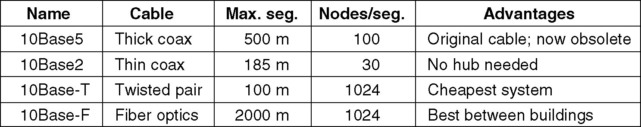
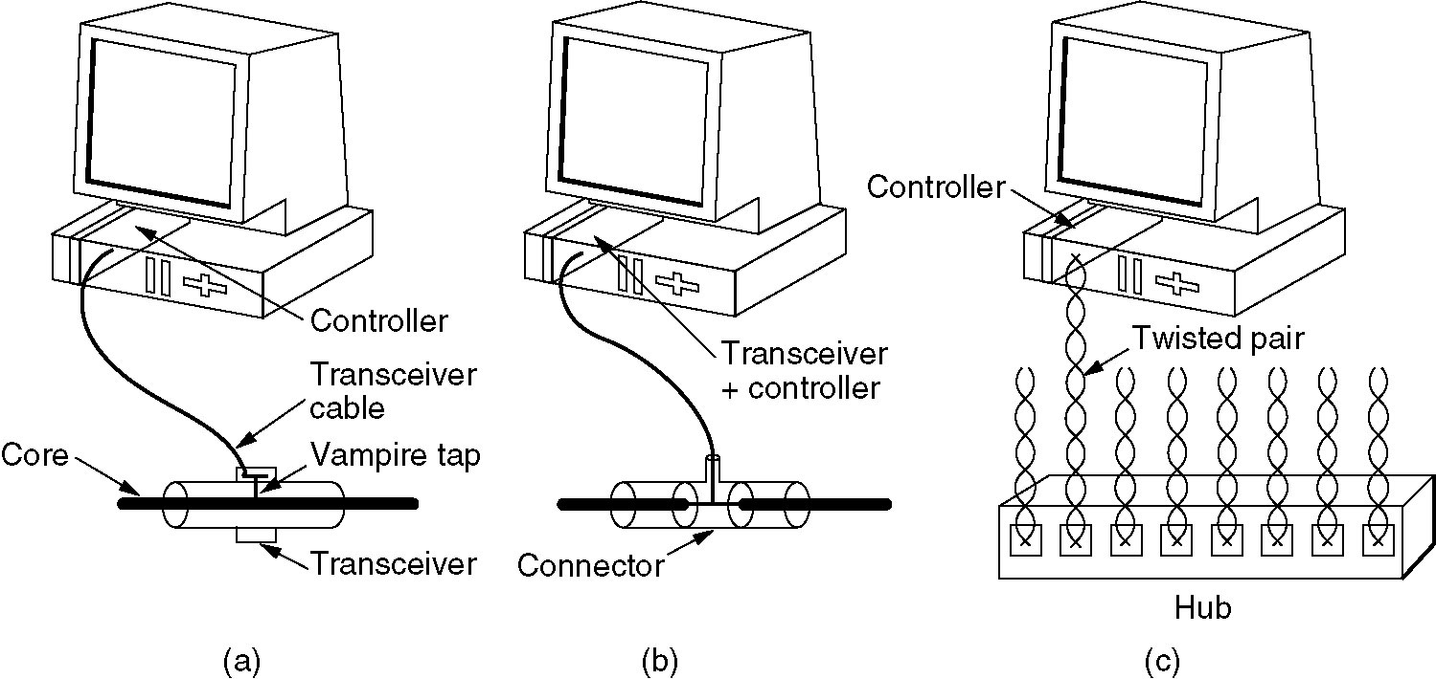
Ethernet Cabling
The most common kinds of Ethernet cabling.
Three kinds of Ethernet cabling.
(a) 10Base5, (b) 10Base2, (c) 10Base-T.

Slide 14
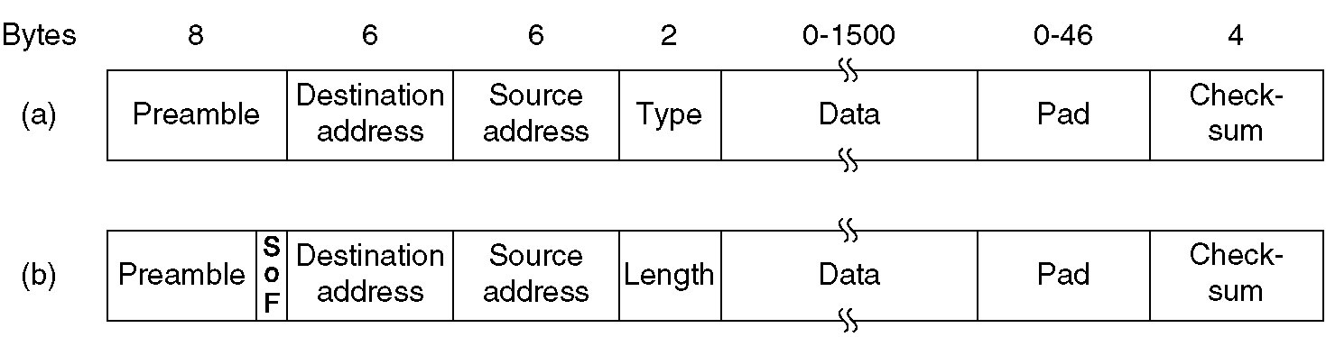
Ethernet MAC Sublayer Protocol
Frame formats. (a) DIX Ethernet, (b) IEEE 802.3.
Preamble of 8 bytes, each with the bit pattern 10101010. For synchronization between the sender and the receiver. Start of frame (SOF) byte contains 10101011 to denote the start of the frame.
Destination and source addresses, each with 2-6 bytes.
  Ordinary address: the high-order bit value is 0.
  Multicast address: the high-order bit value is 1.
  Broadcast address: all bits have a value of 1.
  Local address: assigned by local network administrator, distinguished by the second high-order bit (46) value 0.
  Global address (7 × 10¹³): assigned by IEEE to ensure world wide uniqueness, distinguished by the second high-order bit value 1.
Type specifies which network-layer process to give the frame to (for supporting multi-protocols at network-layer).

Slide 15
The Minimum Frame Length
Length: 0 - 1500 bytes.
802.3 states that valid frames must be at least 64 bytes. If the length of data is less than 46 bytes, padding bytes are stuffed.
Why specifies the minimum frame length?
To make it easier to distinguish valid frames from garbage,
Another more important reason for having a minimum length frame is to prevent a station from completing the transmission of a short frame before the first bit has even reached the far end of the cable, which it may collide with another frame, as illustrated below.

Slide 16


Collision Detection Time and Minimal Frame Length
A
B
At time 0, A sends out one frame.
At time τ - ε, the frame almost arrives at B.
At the same time, B sends out one frame.
B detects the collision immediately (at time τ – ε).
The frame from B arrives at A at time 2τ.
A detects the collision (at time 2τ).
In a 10M bps LAN of 2500 meters and 4 repeaters, the round trip time is 50 usec. 1 bit takes 100 nsec, so 500 bits is the smallest frame that is guaranteed to work.
500 bits ≈ 512 bits = 64 bytes.

Slide 17
The Binary Exponential Backoff Algorithm
After a collision, the station waits for a random time and try again. How the randomization is done ?
Time is divided into discrete slots whose length is equal to the worst case round trip propagation time (2τ).
  After the first collision, each station waits either 0 or 1 slot time at random.
  After the second collision, each station waits either 0, 1, 2, or 3 slot times at random.
  After i collisions, a random number between 0 and 2**i – 1 is chosen, and that number of slots is skipped.
  After 10 collisions have been reached, the randomization interval is frozen at 1023 slots.
  After 16 collisions, the controller gives up and reports failure.

Slide 18

The Binary Exponential Backoff Algorithm – Discussion
What happens if the randomization interval for all collisions is always 1023?
Think about the average delay when only a few stations collide.
What happens if the randomization interval for all collisions is always 2?
Think about the time needed to resolve the collision when 100 stations try to send at once. This might take years to resolve.
The mean number of times per transmission is e ≈ 2.72.

Slide 19
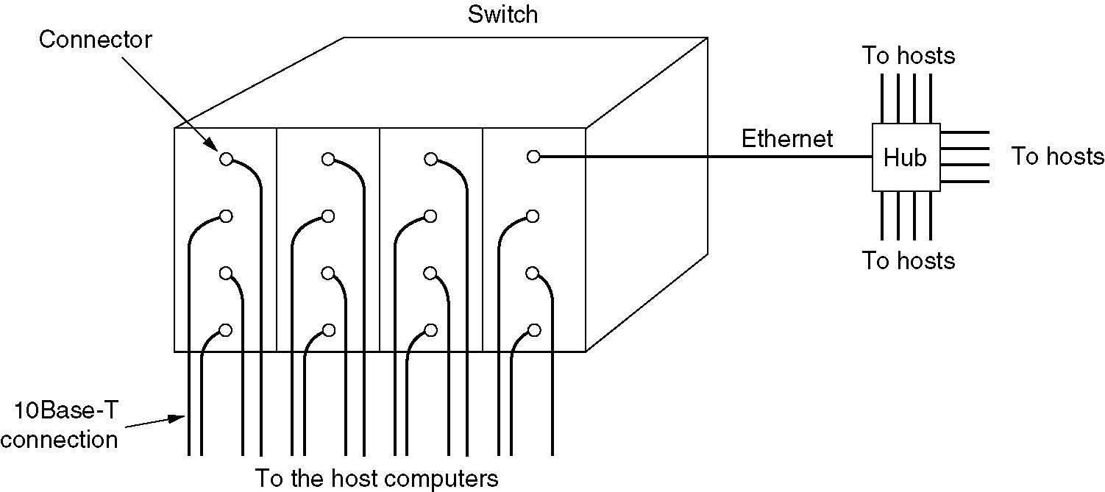
Switched Ethernet
The heart of the system is a switch containing a high-speed (typically over 1 Gbps) backplane and room for multiple plug-in cards (typically 4 to 32), with one to eight connectors in each card.
  To transmit, a station outputs a standard 802.3 frame to a plug-in card in the switch.
  The plug-in card checks to see if the frame is destined for one of the other stations connected to the same card. If so, the frame is copied there. If not, the frame is sent over the high-speed backplane to the destination station's card.

Slide 20
Switched Ethernet (2)
What happens if two machines attached to the same plug-in card transmit frames at the same time ?
In case that all the ports on the card are wired together to form a local on-card LAN:
  Collisions on this on-card LAN will be detected and handled the same as any other collisions on a CSMA/DC network.
  Only one transmission per card is possible at any instant, but all the cards can be transmitting in parallel.
In case that each input port is buffered, so incoming frames are stored in the card's on-board RAM as they arrive:
  Once a frame has been completely received, the card checks to see if the frame is destined for another port on the same card, or for a distant port. In the former case it can be transmitted directly to the destination.
  In the latter case, it must be transmitted over the backplane to the proper card.
  All input ports can receive (and transmit) frames at the same time, for parallel, full-duplex operation.

Slide 21
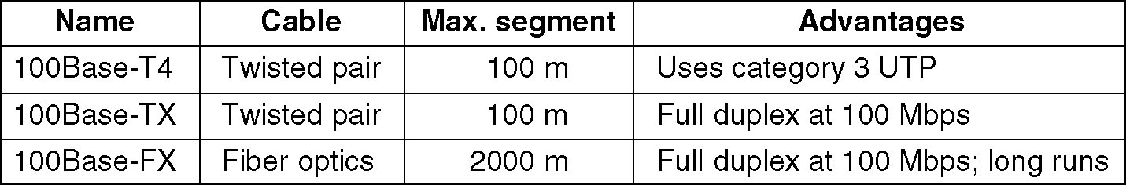
Fast Ethernet
The Fast Ethernet (IEEE 802.3u) is backward compatible with but faster than the existing 802.3 standard.
All the 802.3 packet formats, interfaces, and procedural rules are kept, but the bit time is reduced from 100 (10 Mbps) nsec to 10 nsec (100 Mbps).
Fast Ethernet is based entirely on twisted pair or fiber wiring, as shown below.

Slide 22
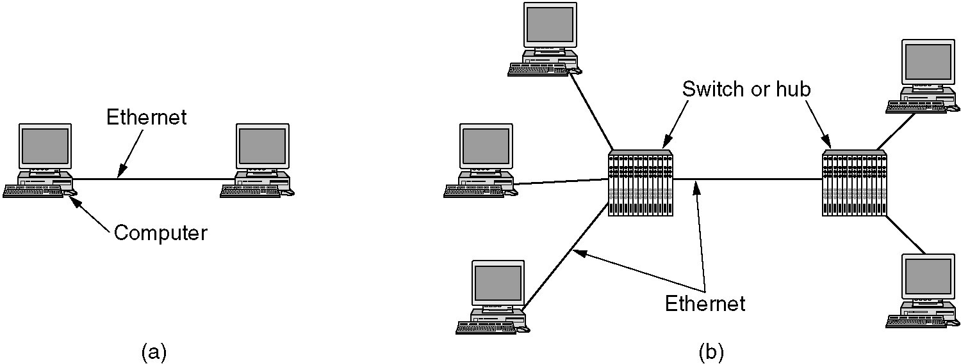
Gigabit Ethernet
The Gigabit Ethernet (IEEE 802.3z) is backward compatible with but faster than the existing 802.3 and 802.3u standards, but goes 10 times faster than 802.3u.
All configurations of gigabit Ethernet are point-to-point.
(a) A two-station Ethernet. (b) A multistation Ethernet.

Slide 23
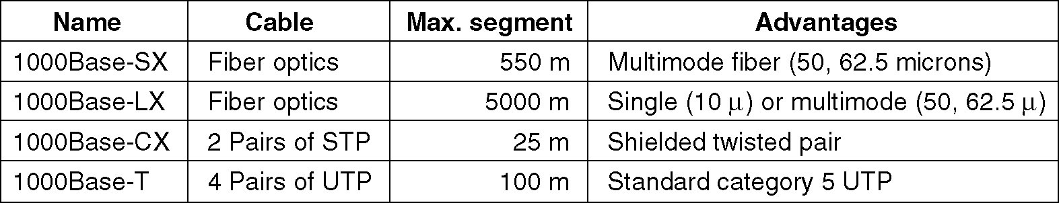
Gigabit Ethernet cabling
Gigabit Ethernet supports both copper and fiber cabling.
Gigabit Ethernet uses new encoding schemes, rather than Manchester encoding.
Gigabit Ethernet supports flow control: one end can send a special control frame to the other end telling it to pause for some period of time. The time unit is 512 nsec, allowing for pause as long as 33.6 msec.
IEEE 802 committee has produced the 10-gigabit Ethernet standard 802.3ae in 2002.

Slide 24
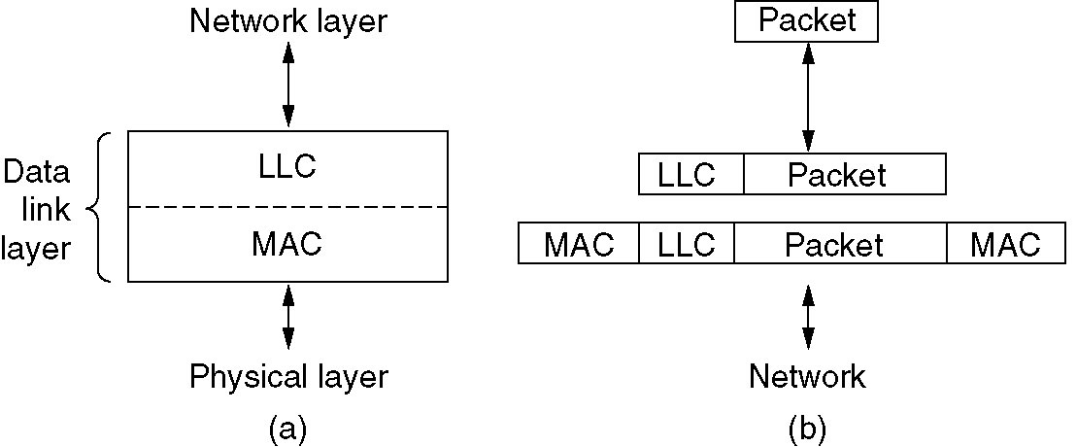
IEEE 802.2: Logical Link Control
LLC hides the differences between the various kinds of 802 networks by providing a single format and interface to the network layer.
LLC provides three service options: unreliable datagram service, acknowledged datagram service, and reliable connection-oriented service.
(a) Position of LLC. (b) Protocol formats.

Slide 25
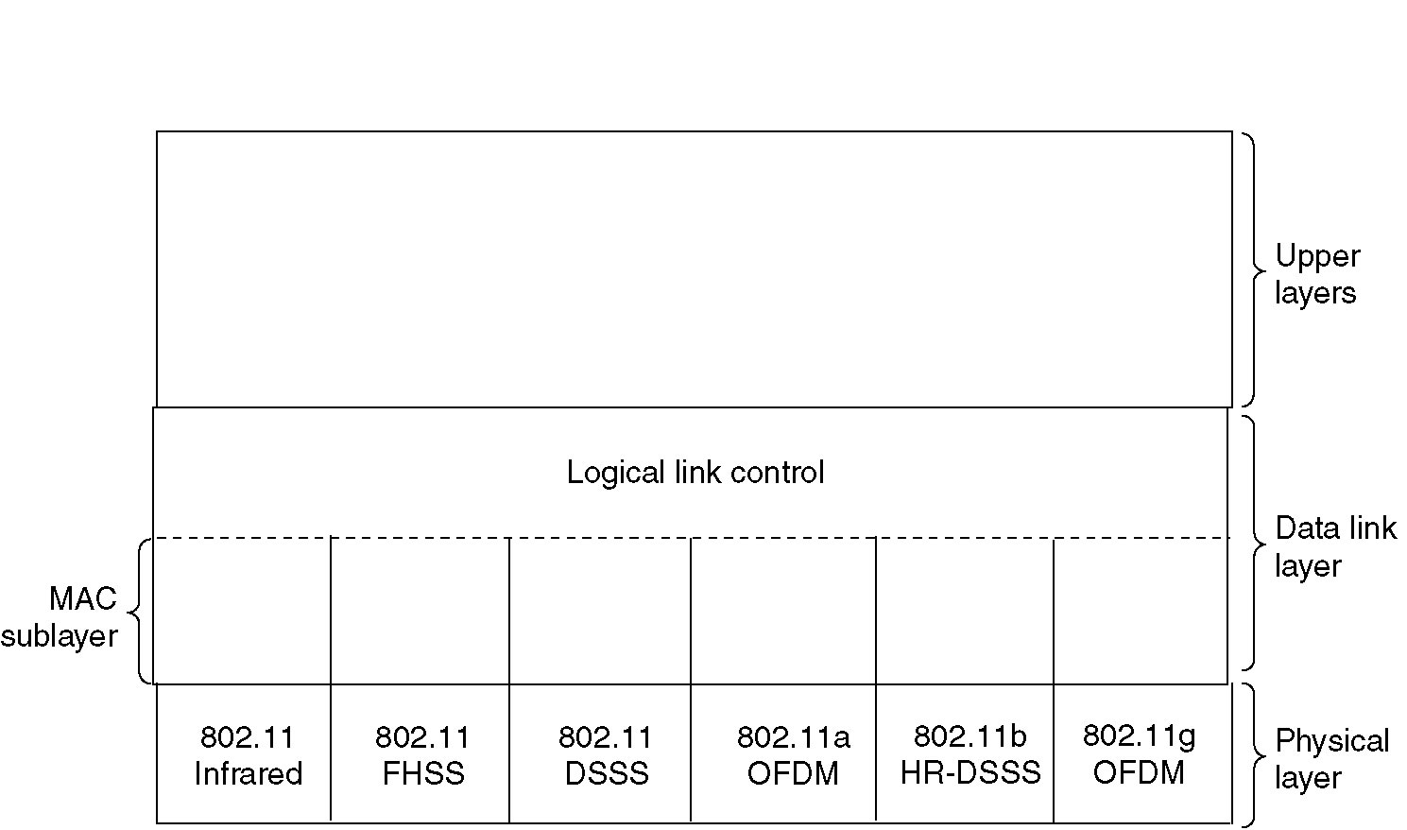
Wireless LANs
Wireless LANs are increasingly popular and deployed in office buildings, airports and other public places.
Wireless LANs can operate with or without a base station.
IEEE 802.11 LAN standard makes provision for both arrangements.
Part of the 802.11 protocol stack.

Slide 26
Bluetooth
In 1994, Ericsson, IBM, Intel, Nokia, and Toshiba formed SIG to develop a wireless standard for interconnecting computing and communication devices and accessories using short-range, low-power, inexpensive wireless radios. This project was named Bluetooth, after Harald Blaatand (Bluetooth) II (940-981), a Viking king who unified Denmark and Norway, also without cables.
The original idea was just to get rid of the cables between devices, but it soon began to expand in scope and encroach on the area of wireless LANs. It creates competition with 802.11 and even interferes with 802.11 electronically (using the same 2.4-GHz ISM band).
In 1999, Bluetooth SIG issued a 1500-page specification V1.0 (from physical to application layers), part of which (physical and data-link layers) was adopted by IEEE as the basis for a wireless PAN (Personal Area Network) standard, 802.15.1 (2002).

Slide 27
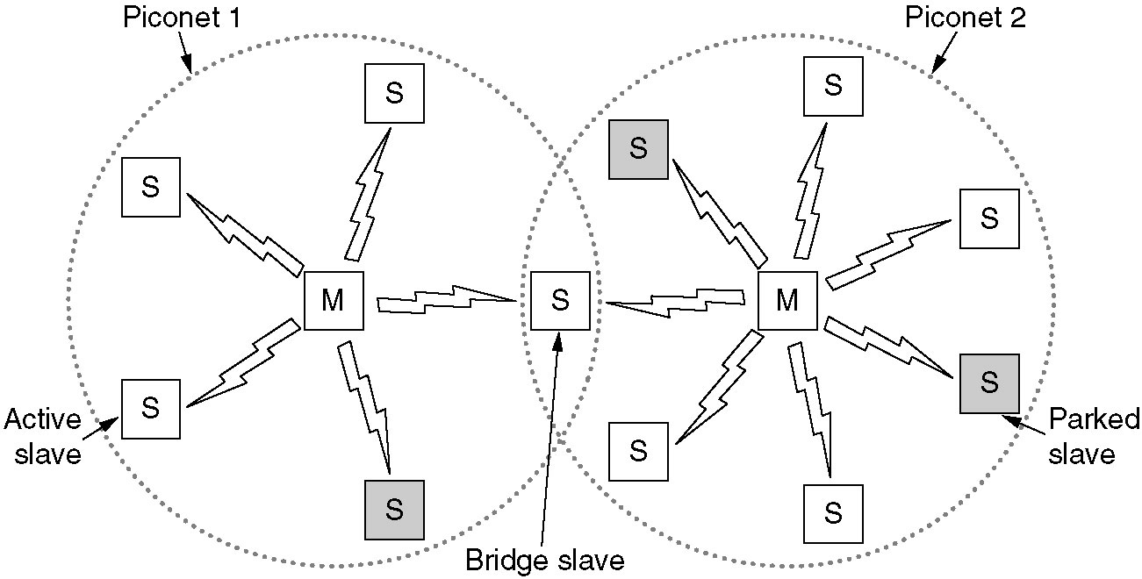
Bluetooth Architecture
The basic unit of a Bluetooth system is a piconet, which consists of a master node and up to seven active slave nodes within a distance of 10 meters.
There can be up to 255 parked nodes in a piconet, which are devices that the master has switched to a low-power state to reduce the drain on their batteries.
All communication is between the master and a slave, using TDM; no direct slave-slave communication is possible.
Multiple piconets can exist in the same room and be connected via a bridge node. An interconnected collection of piconet is called a scatternet.

Slide 28
Data Link Layer Switching
LANs can be connected by devices called bridges, which operate in the data link layer. This means that bridges do not examine the network layer header and can thus copy IPv4, IPv6, AppleTalk, ATM, IPX, and OSI packets equally well.
Most bridges connect 802 LANs, so we will concentrate primarily on 802 bridges.
Reasons why a single organization may end up with multiple LANs and bridges are needed:
  Different goals of different departments.
  Geographical distance (cheaper and shorter delay).
  Accommodation of the heavy load.
  The matter of reliability and security.

Slide 29
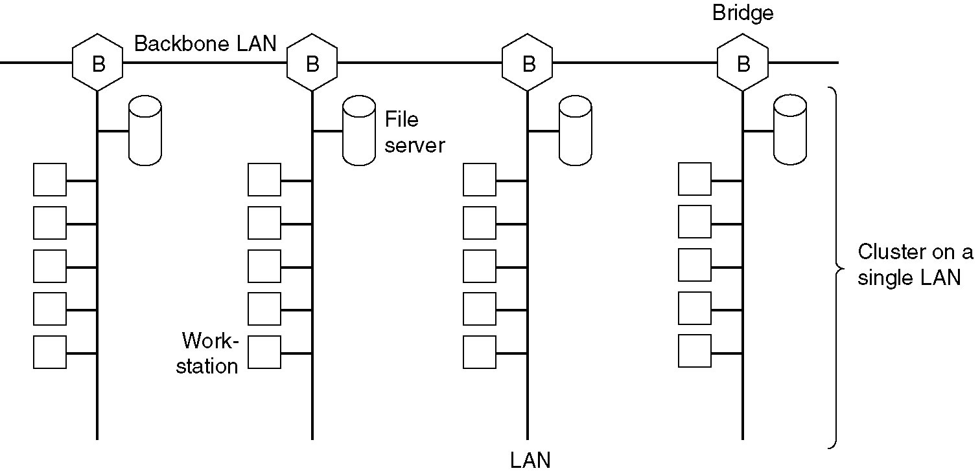
Data Link Layer Switching
Multiple LANs connected by a backbone to handle a total load higher than the capacity of a single LAN.

Slide 30
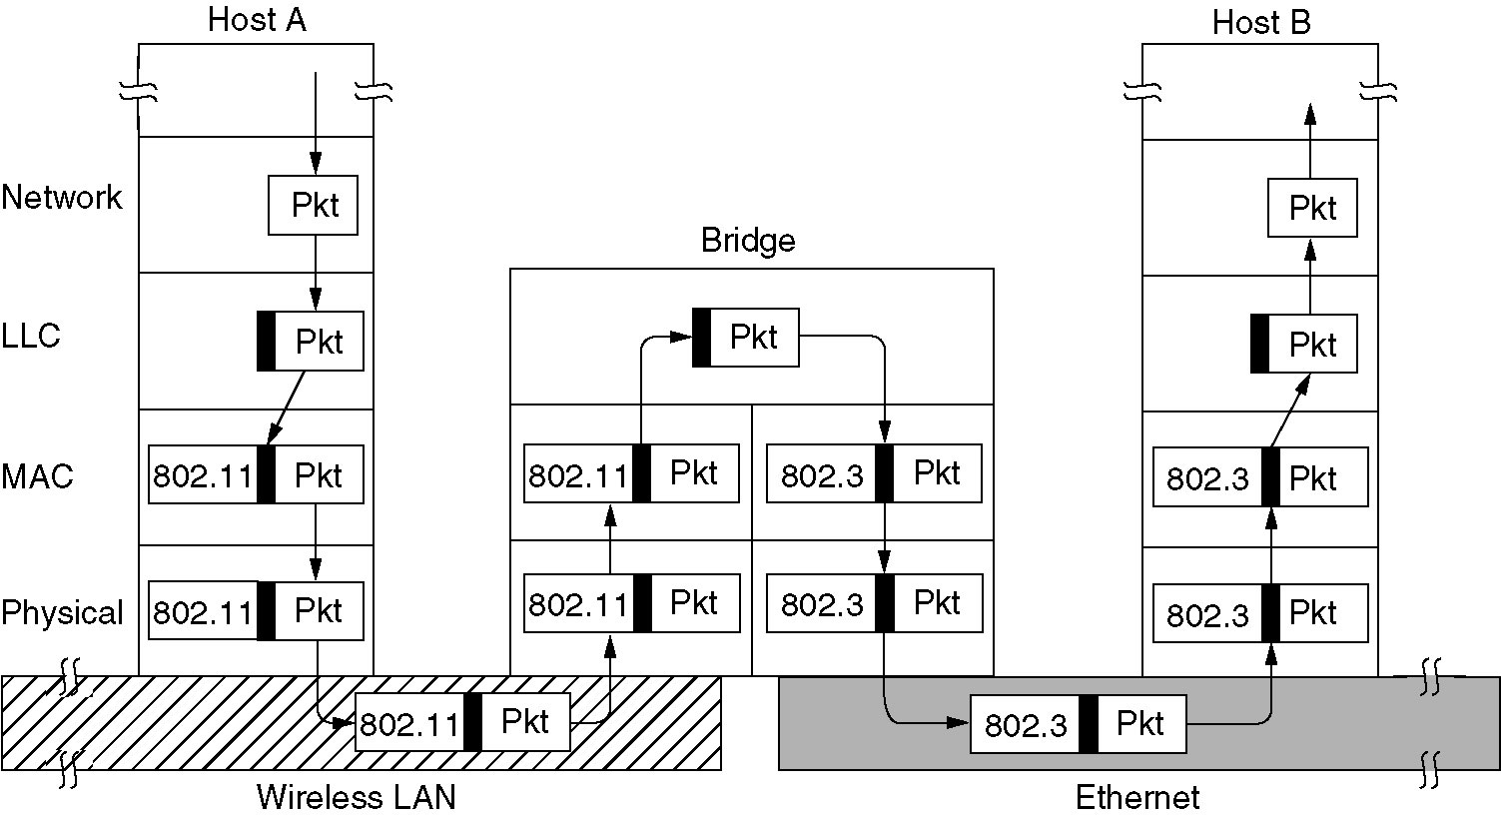
Bridges from 802.x to 802.y
Operation of a LAN bridge from 802.11 to 802.3.
Notes:
The LLC header remains in the bridge.

Slide 31
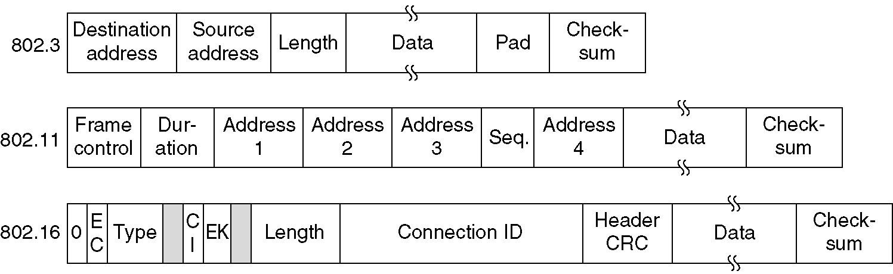
Bridges from 802.x to 802.y (2)
The IEEE 802 frame formats. The drawing is not to scale.
General problems:
  Different frame formats. Solution: reformatting.
  Different data rates (802.3z 1Gbps and 802.11b 11Mbps). Solution: buffering.
  Different maximum frame length (e.g., 802.3 1518 bytes, 802.11 2312 bytes, 802.16 1000 (?) bytes, and 802.15.1 2744 bytes). No solution.
  Security: 802.11 and 802.16 support encryption but 802.3 does not.
  Quality of service: 802.11 and 802.16 have but 802.3 does not.

